Slide 1
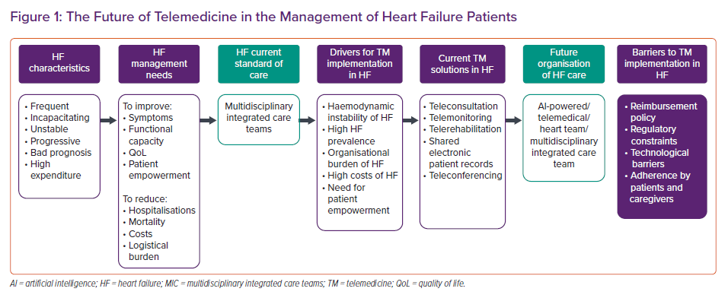
Silva-Cardoso J, González Juanatey JR, Comin-Colet J, Sousa JM, Cavalheiro A, Moreira E
The Future of Telemedicine in the Management of Heart Failure Patients
Citation: Cardiac Failure Review 2021;7:e11.
https://doi.org/10.15420/cfr.2020.32

