Slide 1
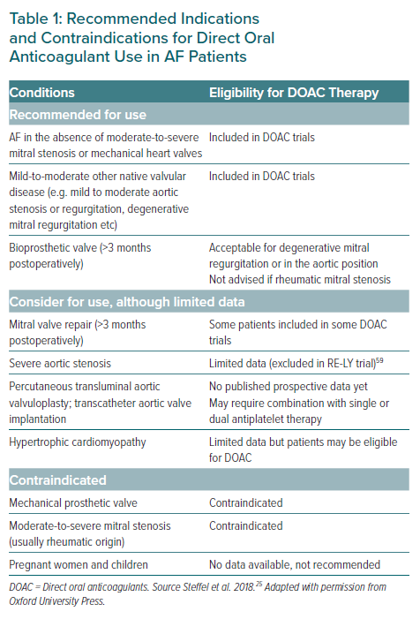
Chong DT, Andreotti F, Verhamme P, Dalal JJ, Uaprasert N, Wang CC, On YK, Li YH, Jiang J, Hasegawa K, Almuti K, Bai R, Lo ST, Krittayaphong R, Lee LH, Quek D, Johar S, Chong SS, Hammett CJ, Tan JW
Recommended Indications and Contraindications for Direct Oral Anticoagulant Use in AF Patients
Citation: European Cardiology Review 2021;16:e23.
https://doi.org/10.15420/ecr.2020.43

