Slide 1
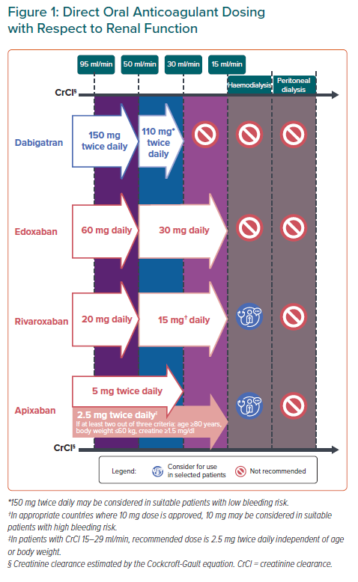
Chong DT, Andreotti F, Verhamme P, Dalal JJ, Uaprasert N, Wang CC, On YK, Li YH, Jiang J, Hasegawa K, Almuti K, Bai R, Lo ST, Krittayaphong R, Lee LH, Quek D, Johar S, Chong SS, Hammett CJ, Tan JW
Direct Oral Anticoagulant Dosing with Respect to Renal Function
Citation: European Cardiology Review 2021;16:e23.
https://doi.org/10.15420/ecr.2020.43

