Slide 1
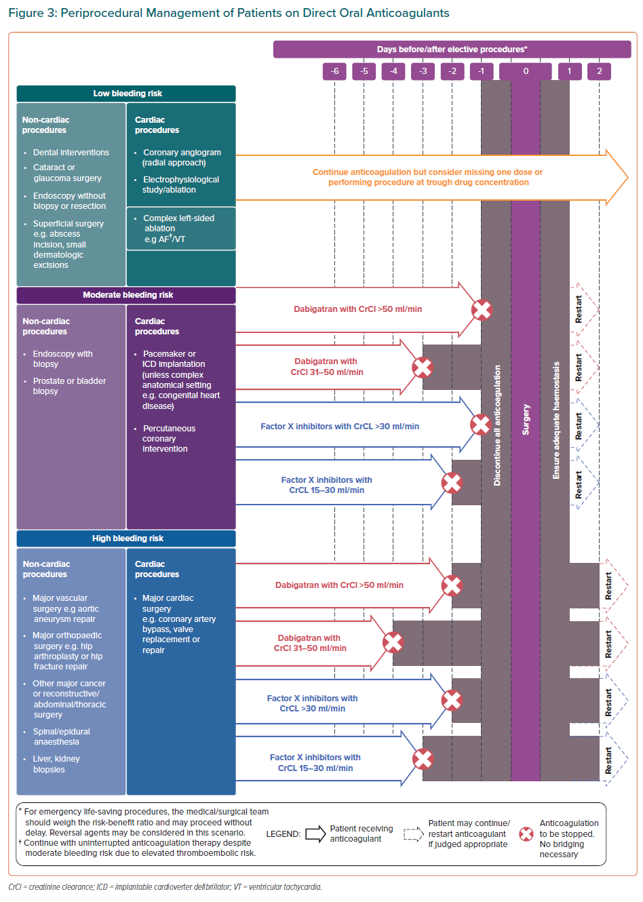
Chong DT, Andreotti F, Verhamme P, Dalal JJ, Uaprasert N, Wang CC, On YK, Li YH, Jiang J, Hasegawa K, Almuti K, Bai R, Lo ST, Krittayaphong R, Lee LH, Quek D, Johar S, Chong SS, Hammett CJ, Tan JW
Periprocedural Management of Patients on Direct Oral Anticoagulants
Citation: European Cardiology Review 2021;16:e23.
https://doi.org/10.15420/ecr.2020.43

