Slide 1
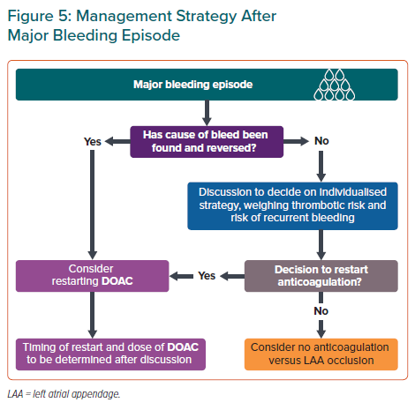
Chong DT, Andreotti F, Verhamme P, Dalal JJ, Uaprasert N, Wang CC, On YK, Li YH, Jiang J, Hasegawa K, Almuti K, Bai R, Lo ST, Krittayaphong R, Lee LH, Quek D, Johar S, Chong SS, Hammett CJ, Tan JW
Management Strategy After Major Bleeding Episode
Citation: European Cardiology Review 2021;16:e23.
https://doi.org/10.15420/ecr.2020.43

