Slide 1
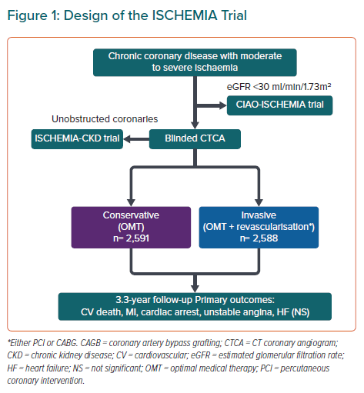
Ako E, Nijjer S, Al-Hussaini A, Kaprielian R
Design of the ISCHEMIA Trial
Citation: European Cardiology Review 2021;16:e24.
https://doi.org/10.15420/ecr.2020.37

