Slide 1
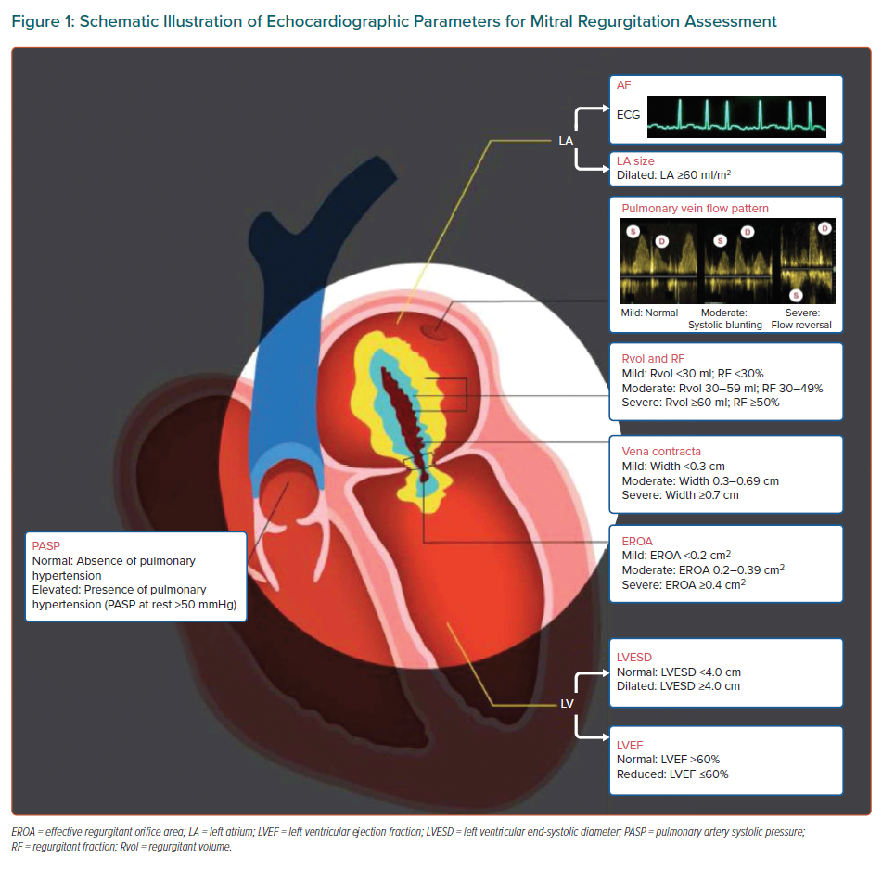
Yeo KK, Tan JWC, Muller DW, Walters DL, Lindenfeld J, Lee MKY, Fung Chui AS, Satish S, Santoso T, Kubo S, Kok Meng JC, Sin KYK, Ewe SH, Sim D, Tay EL, Meemook K, Sung SH, Nguyen QN, Pan X, Amaki M, Izumo M, Hayashida K, Kim JS, Kang DY, Stone G, Matsumoto T
Schematic Illustration of Echocardiographic Parameters for Mitral Regurgitation Assessment
Citation: European Cardiology Review 2021;16:e25.
https://doi.org/10.15420/ecr.2021.01

