Slide 1
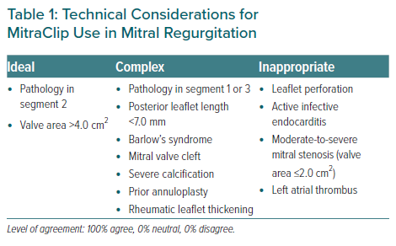
Yeo KK, Tan JWC, Muller DW, Walters DL, Lindenfeld J, Lee MKY, Fung Chui AS, Satish S, Santoso T, Kubo S, Kok Meng JC, Sin KYK, Ewe SH, Sim D, Tay EL, Meemook K, Sung SH, Nguyen QN, Pan X, Amaki M, Izumo M, Hayashida K, Kim JS, Kang DY, Stone G, Matsumoto T
Technical Considerations for MitraClip Use in Mitral Regurgitation
Citation: European Cardiology Review 2021;16:e25.
https://doi.org/10.15420/ecr.2021.01

