Slide 1
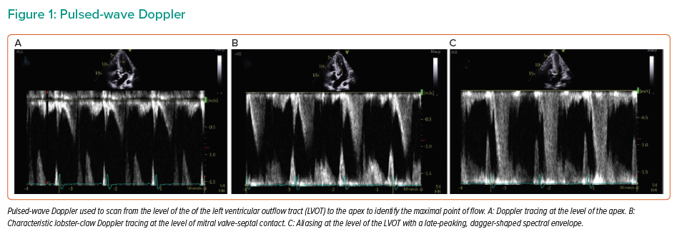
Bansal P, Lodhi H, Mathews A, Desai A, Morcos R, Maini B, Khalili H
Pulsed-wave Doppler
Citation: Interventional Cardiology Review 2021;16:e11.
https://doi.org/10.15420/icr.2020.36

