Slide 1
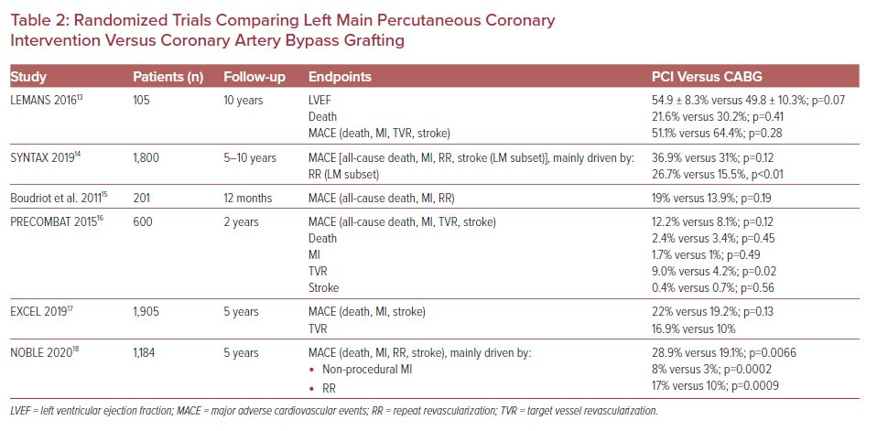
Varlamos C, Lianos I, Benetou DR, Alexopoulos D
Randomized Trials Comparing Left Main Percutaneous Coronary Intervention Versus Coronary Artery Bypass Grafting
Citation: US Cardiology Review 2021;15:e11.
https://doi.org/10.15420/usc.2020.34

