Slide 1
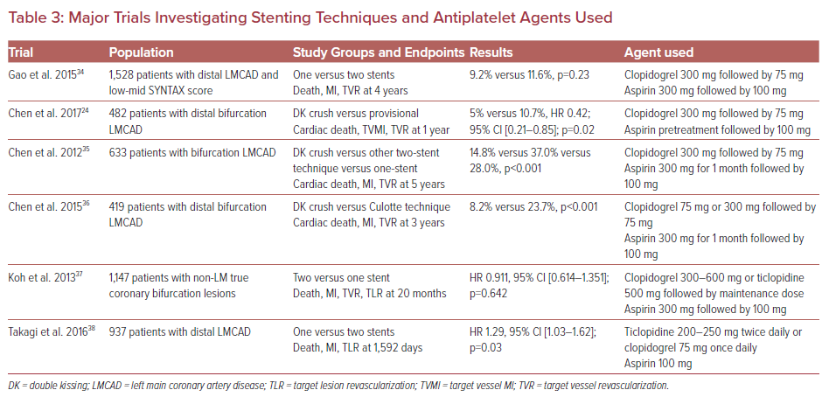
Varlamos C, Lianos I, Benetou DR, Alexopoulos D
Major Trials Investigating Stenting Techniques and Antiplatelet Agents Used
Citation: US Cardiology Review 2021;15:e11.
https://doi.org/10.15420/usc.2020.34

