Slide 1
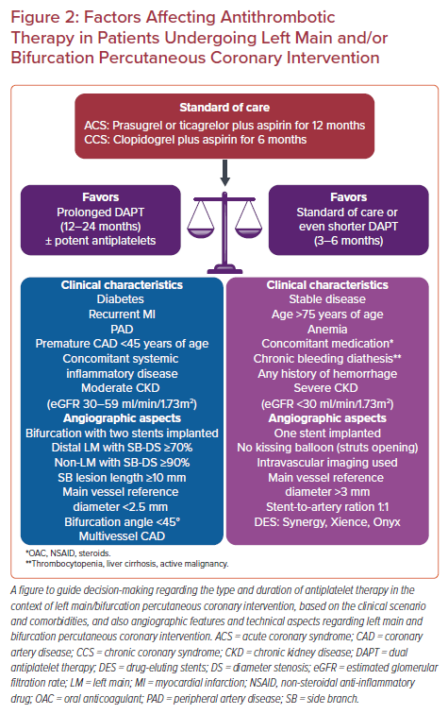
Varlamos C, Lianos I, Benetou DR, Alexopoulos D
Factors Affecting Antithrombotic Therapy in Patients Undergoing Left Main and/or Bifurcation Percutaneous Coronary Intervention
Citation: US Cardiology Review 2021;15:e11.
https://doi.org/10.15420/usc.2020.34

