Slide 1
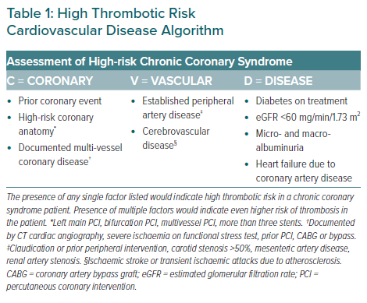
Tan JWC, Chew DP, Brieger D, Eikelboom J, Montalescot G, Ako J, Kim BK, Quek D, Aitken SJ, Chow CK, Chour S, Tse HF, Kaul U, Firdaus I, Kubo T, Liew BW, Chong TT, Sin KYK, Yeh HI, Buddhari W, Chunhamaneewat N, Hasan F, Fox KA, Nguyen QN, Lo ST
High Thrombotic Risk Cardiovascular Disease Algorithm
Citation: European Cardiology Review 2021;16:e26.
https://doi.org/10.15420/ecr.2020.45

