Slide 1
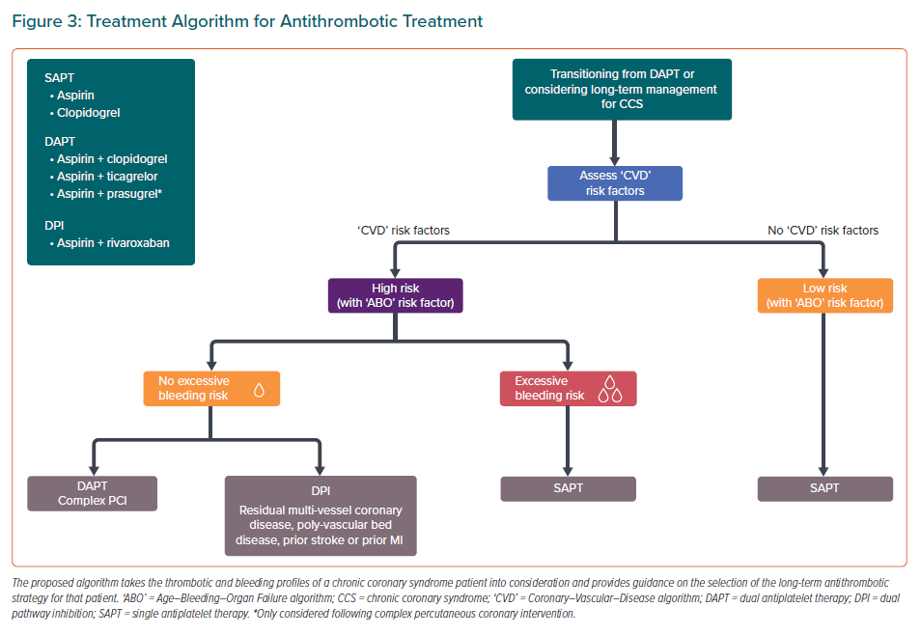
Tan JWC, Chew DP, Brieger D, Eikelboom J, Montalescot G, Ako J, Kim BK, Quek D, Aitken SJ, Chow CK, Chour S, Tse HF, Kaul U, Firdaus I, Kubo T, Liew BW, Chong TT, Sin KYK, Yeh HI, Buddhari W, Chunhamaneewat N, Hasan F, Fox KA, Nguyen QN, Lo ST
Treatment Algorithm for Antithrombotic Treatment
Citation: European Cardiology Review 2021;16:e26.
https://doi.org/10.15420/ecr.2020.45

