Slide 1
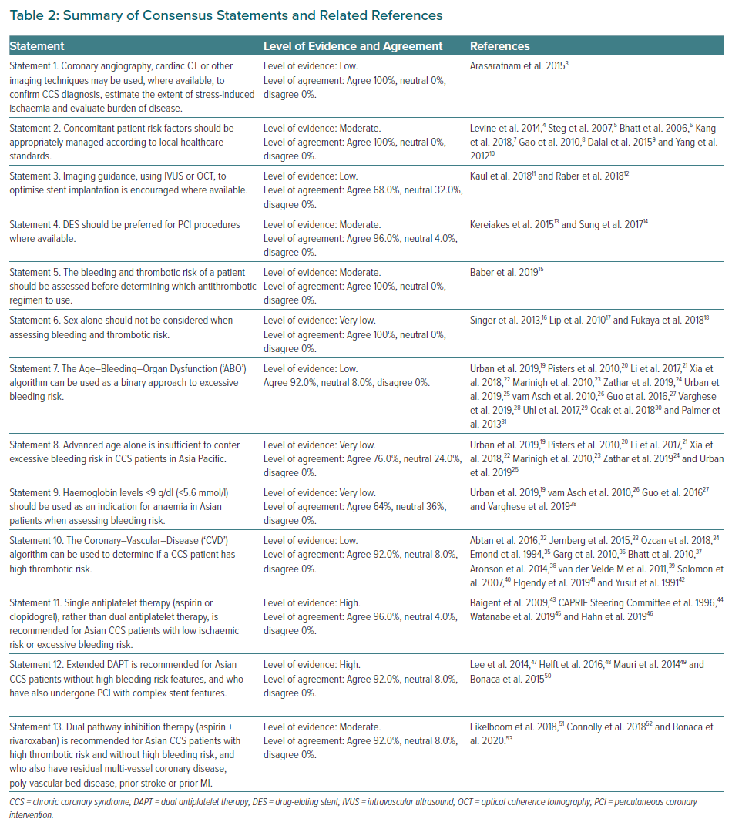
Tan JWC, Chew DP, Brieger D, Eikelboom J, Montalescot G, Ako J, Kim BK, Quek D, Aitken SJ, Chow CK, Chour S, Tse HF, Kaul U, Firdaus I, Kubo T, Liew BW, Chong TT, Sin KYK, Yeh HI, Buddhari W, Chunhamaneewat N, Hasan F, Fox KA, Nguyen QN, Lo ST
Summary of Consensus Statements and Related References
Citation: European Cardiology Review 2021;16:e26.
https://doi.org/10.15420/ecr.2020.45

