Slide 1
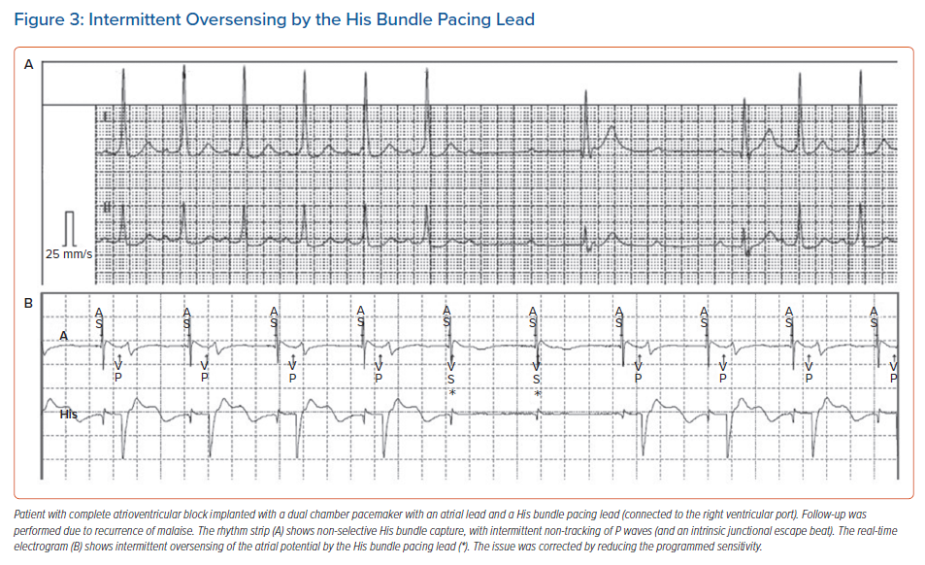
Bakelants E, Burri H
Intermittent Oversensing by the His Bundle Pacing Lead
Citation: Arrhythmia & Electrophysiology Review 2021;10(2):85–90.
https://doi.org/10.15420/aer.2021.16

