Slide 1
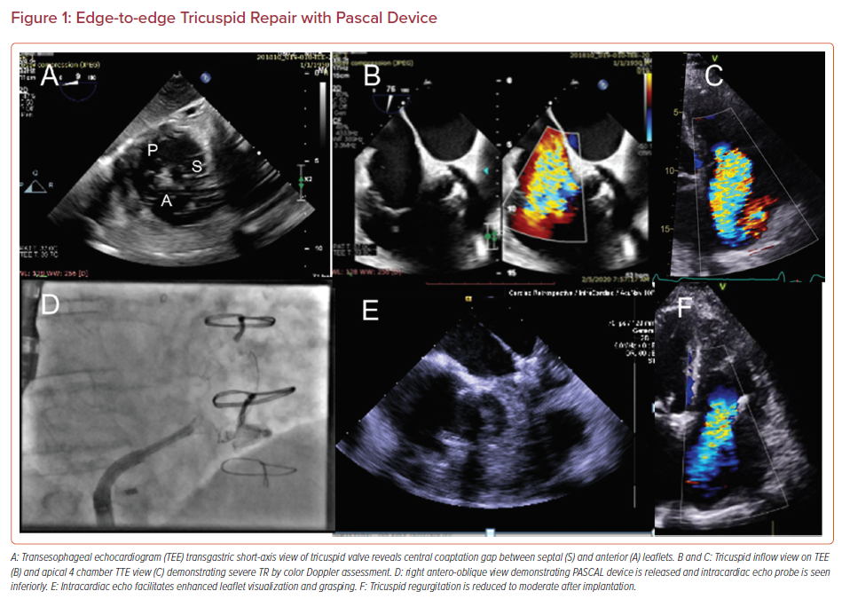
Simard TJ, Eleid MF
Edge-to-edge Tricuspid Repair with Pascal Device
Citation: US Cardiology Review 2021;15:e12.
https://doi.org/10.15420/usc.2020.26

