Slide 1

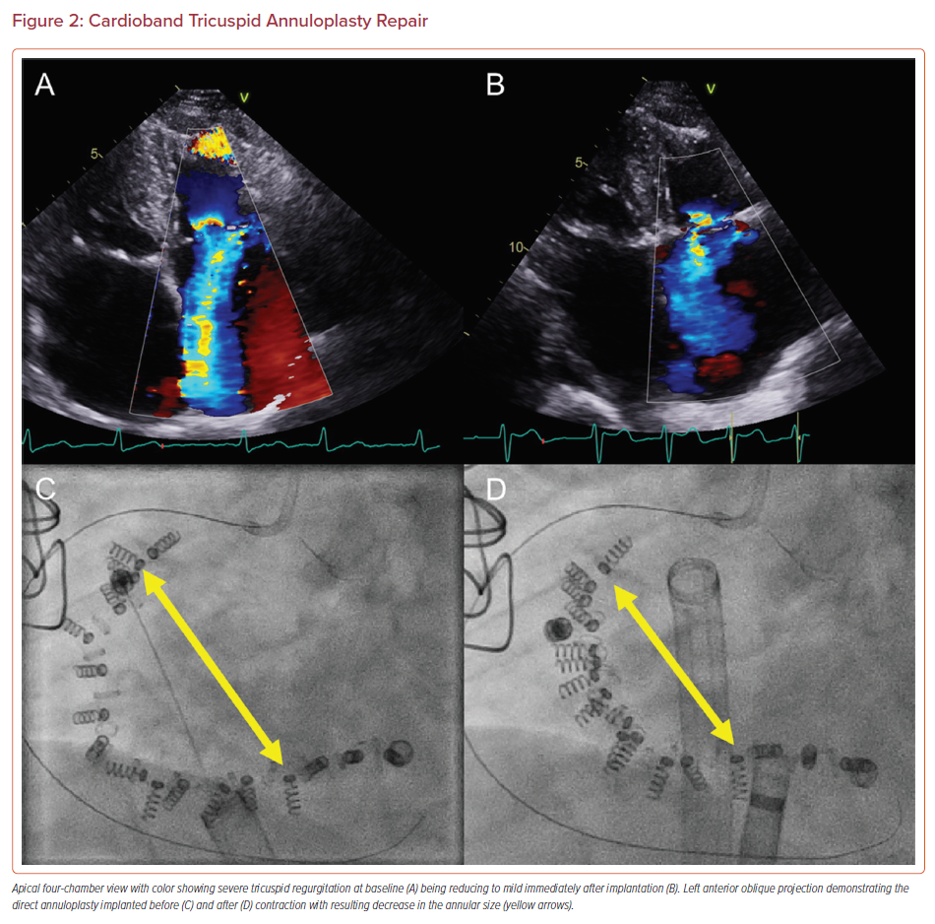
Simard TJ, Eleid MF
Cardioband Tricuspid Annuloplasty Repair
Citation: US Cardiology Review 2021;15:e12.
https://doi.org/10.15420/usc.2020.26

