Slide 1
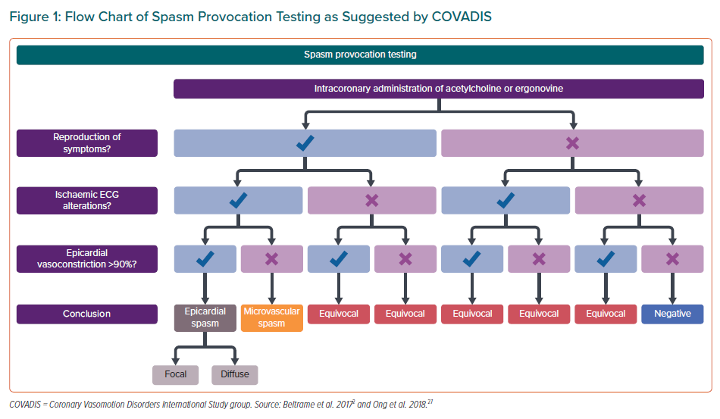
Beck S, Pereyra VM, Seitz A, McChord J, Hubert A, Bekeredjian R, Sechtem U, Ong P
Flow Chart of Spasm Provocation Testing as Suggested by COVADIS
Citation: European Cardiology Review 2021;16:e27.
https://doi.org/10.15420/ecr.2021.06

