Slide 1
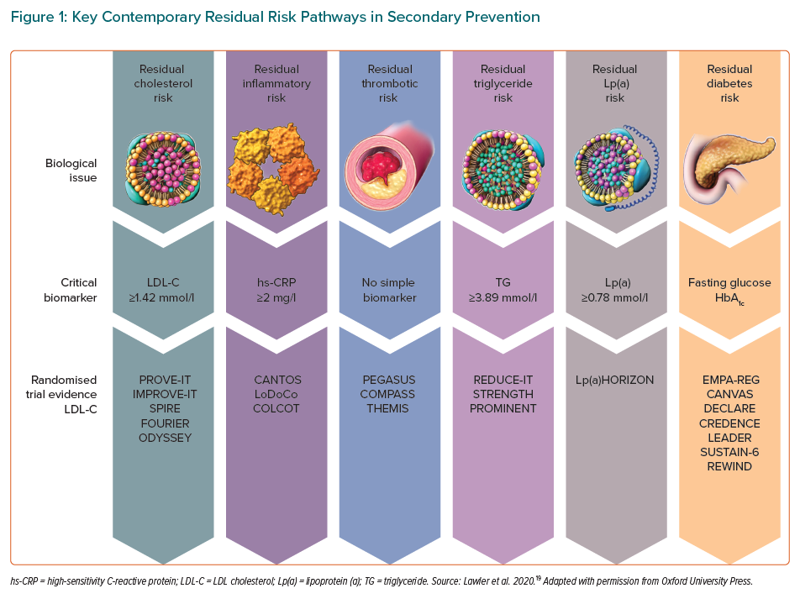
Arroyo-Espliguero R, Viana-Llamas MC, Silva-Obregón A, Avanzas P
Key Contemporary Residual Risk Pathways in Secondary Prevention
Citation: European Cardiology Review 2021;16:e28.
https://doi.org/10.15420/ecr.2020.49

