Slide 1
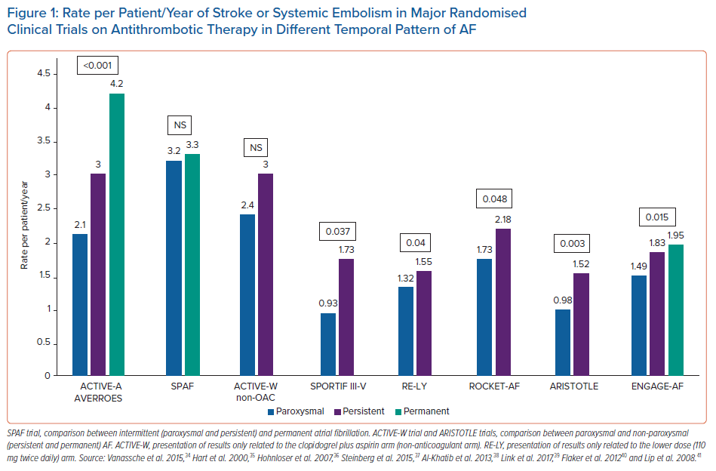
Botto GL, Tortora G, Casale MC, Canevese FL, Maria Brasca FA
Rate per Patient/Year of Stroke or Systemic Embolism in Major Randomised Clinical Trials on Antithrombotic Therapy in Different Temporal Pattern of AF
Citation: Arrhythmia & Electrophysiology Review 2021;10(2):68–76.
https://doi.org/10.15420/aer.2021.01

