Slide 1
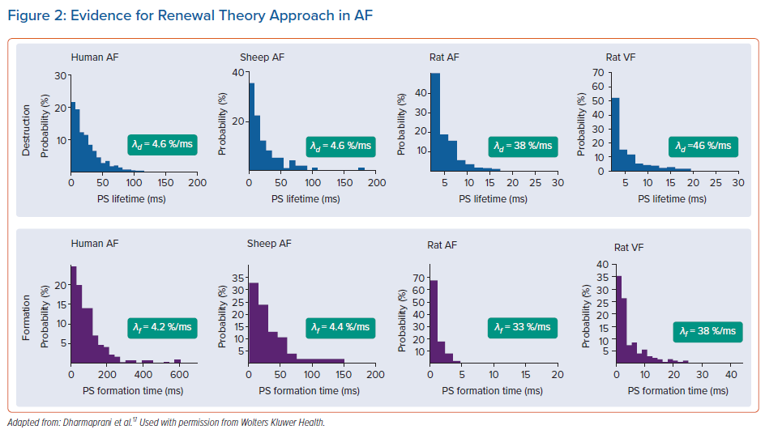
Quah JX, Dharmaprani D, Lahiri A, Tiver K, Ganesan AN
Evidence for Renewal Theory Approach in AF
Citation: Arrhythmia & Electrophysiology Review 2021;10(2):77–84.
https://doi.org/10.15420/aer.2020.42

