Slide 1

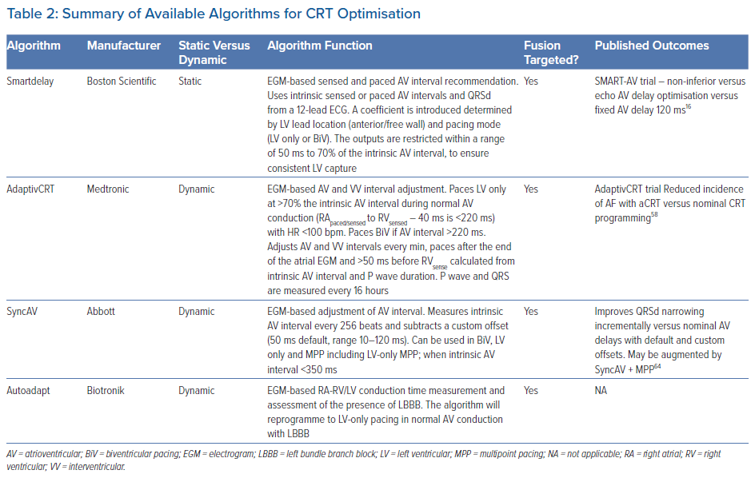
Waddingham PH, Lambiase PD, Muthumala A, Rowland E, Chow AW
Summary of Available Algorithms for CRT Optimisation
Citation: Arrhythmia & Electrophysiology Review 2021;10(2):91–100.
https://doi.org/10.15420/aer.2020.49

