Slide 1
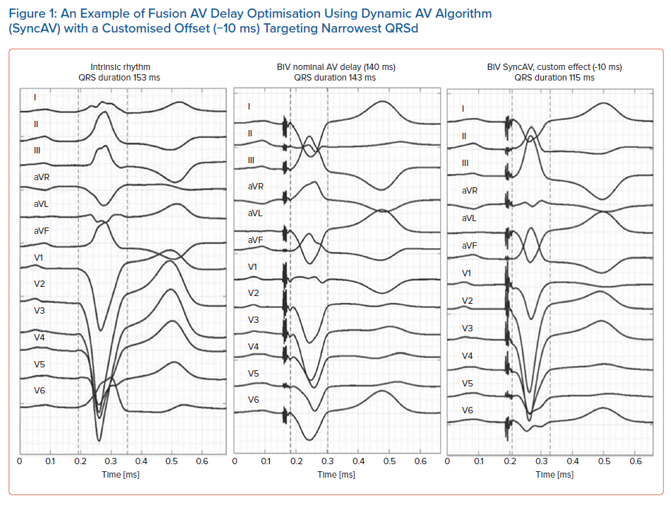
Waddingham PH, Lambiase PD, Muthumala A, Rowland E, Chow AW
An Example of Fusion AV Delay Optimisation Using Dynamic AV Algorithm (SyncAV) with a Customised Offset (−10 ms) Targeting Narrowest QRSd
Citation: Arrhythmia & Electrophysiology Review 2021;10(2):91–100.
https://doi.org/10.15420/aer.2020.49

