Slide 1
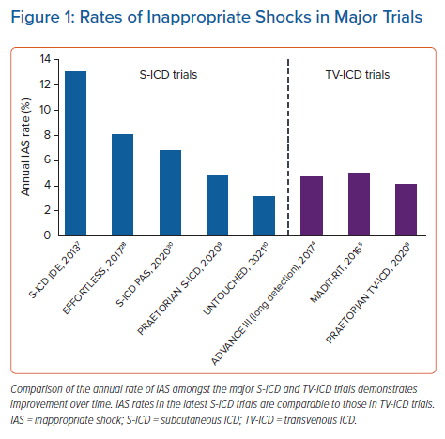
Karimianpour A, John L, Gold MR
Rates of Inappropriate Shocks in Major Trials
Citation: Arrhythmia & Electrophysiology Review 2021;10(2):108–12.
https://doi.org/10.15420/aer.2020.47

