Slide 1
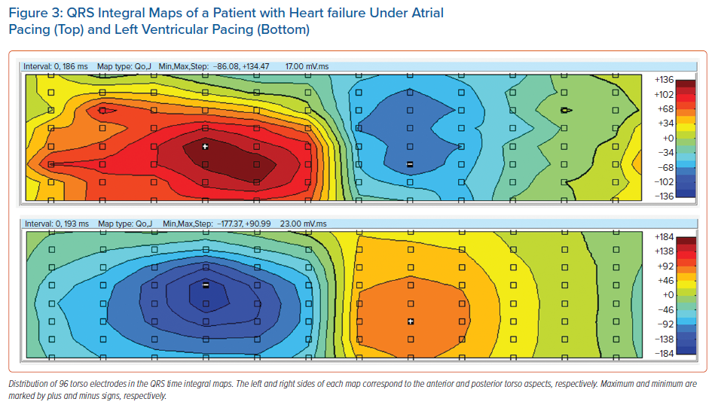
Sedova K, Repin K, Donin G, Dam PV, Kautzner J
QRS Integral Maps of a Patient with Heart failure Under Atrial Pacing (Top) and Left Ventricular Pacing (Bottom)
Citation: Arrhythmia & Electrophysiology Review 2021;10(2):113–9.
https://doi.org/10.15420/aer.2021.14

