Slide 1
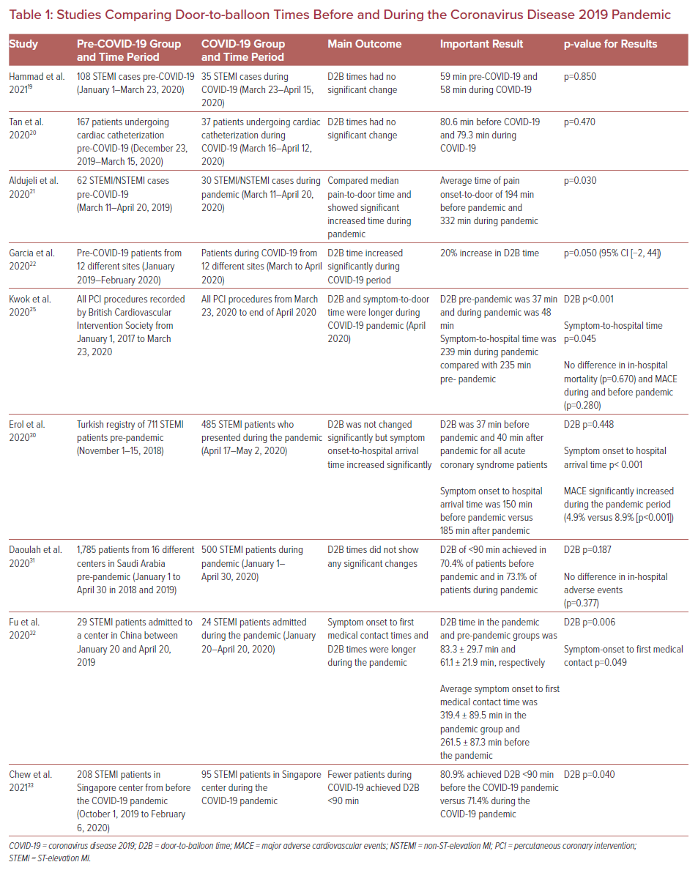
Mously H, Shah N, Zuzek Z, Alshaghdali I, Karim A, Jaswaney R, Filby SJ, Simon DI, Shishehbor M, Forouzandeh F
Studies Comparing Door-to-balloon Times Before and During the Coronavirus Disease 2019 Pandemic
Citation: US Cardiology Review 2021;15:e13.
https://doi.org/10.15420/usc.2021.05

