Slide 1
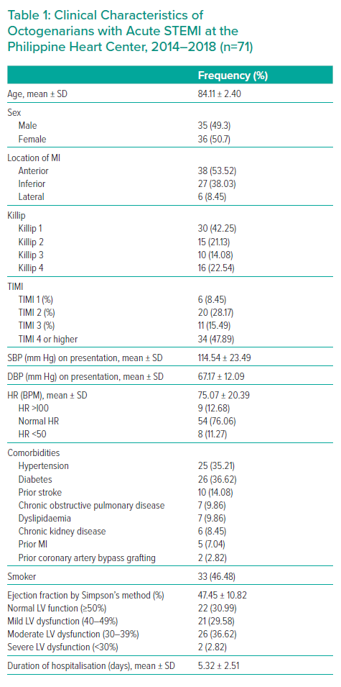
Yap EML, Tuazon AA
Clinical Characteristics of Octogenarians with Acute STEMI at the Philippine Heart Center, 2014–2018 (n=71)
Citation: Interventional Cardiology Review 2021;16:e12.
https://doi.org/10.15420/icr.2021.16.PO1

