Slide 1
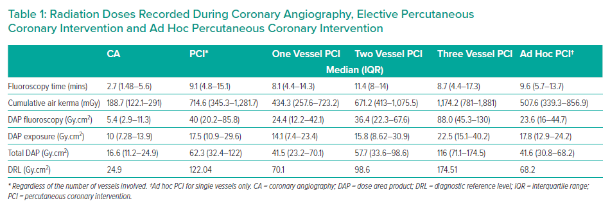
Yap EML, Magno LP, Macaraeg CA, Pedroso GE, Ramos AG, Cruz MZS, Tuazon AA, Estacio RH, Tria RB
Radiation Doses Recorded During Coronary Angiography, Elective Percutaneous Coronary Intervention and Ad Hoc Percutaneous Coronary Intervention
Citation: Interventional Cardiology Review 2021;16:e13.
https://doi.org/10.15420/icr.2021.16.PO2

