Slide 1
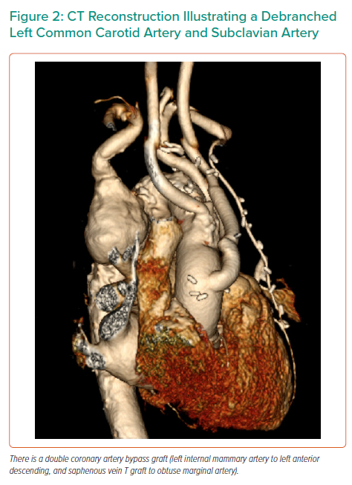
Dinh K, Manuel L, Perera K, Daly T
CT Reconstruction Illustrating a Debranched Left Common Carotid Artery and Subclavian Artery
Citation: Interventional Cardiology Review 2021;16:e14.
https://doi.org/10.15420/icr.2021.16.PO3

