Slide 1
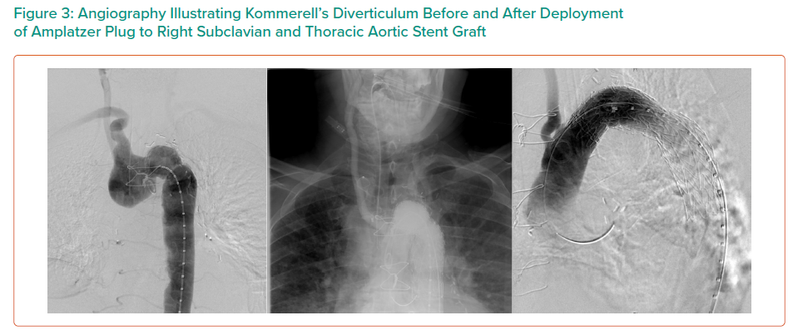
Dinh K, Manuel L, Perera K, Daly T
Angiography Illustrating Kommerell’s Diverticulum Before and After Deployment of Amplatzer Plug to Right Subclavian and Thoracic Aortic Stent Graft
Citation: Interventional Cardiology Review 2021;16:e14.
https://doi.org/10.15420/icr.2021.16.PO3

