Slide 1
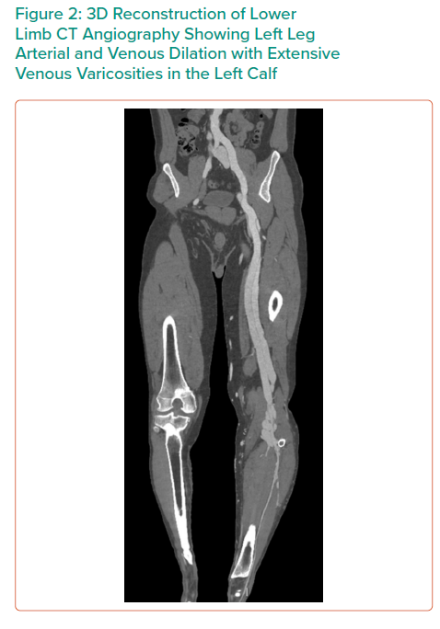
Dinh K, Ying A, Al-Asady R, Vicaretti M
3D Reconstruction of Lower Limb CT Angiography Showing Left Leg Arterial and Venous Dilation with Extensive Venous Varicosities in the Left Calf
Citation: Interventional Cardiology Review 2021;16:e15.
https://doi.org/10.15420/icr.2021.16.PO4

