Slide 1
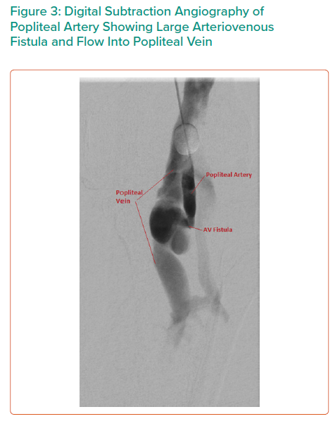
Dinh K, Ying A, Al-Asady R, Vicaretti M
Digital Subtraction Angiography of Popliteal Artery Showing Large Arteriovenous Fistula and Flow Into Popliteal Vein
Citation: Interventional Cardiology Review 2021;16:e15.
https://doi.org/10.15420/icr.2021.16.PO4

