Slide 1
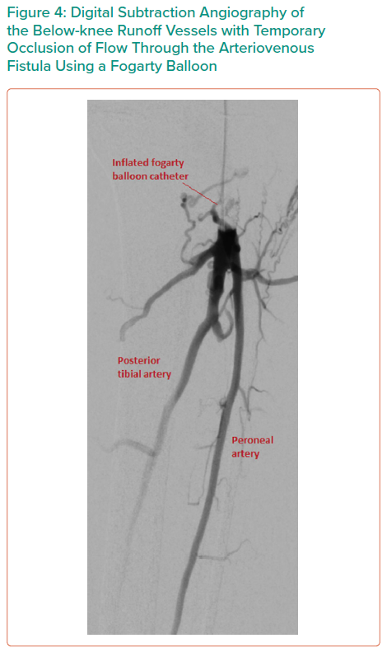
Dinh K, Ying A, Al-Asady R, Vicaretti M
Digital Subtraction Angiography of the Below-knee Runoff Vessels with Temporary Occlusion of Flow Through the Arteriovenous Fistula Using a Fogarty Balloon
Citation: Interventional Cardiology Review 2021;16:e15.
https://doi.org/10.15420/icr.2021.16.PO4

