Slide 1
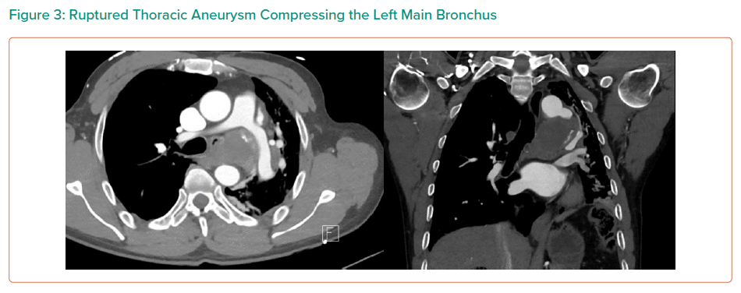
Dinh K, Manuel L, Vicaretti M
Ruptured Thoracic Aneurysm Compressing the Left Main Bronchus
Citation: Interventional Cardiology Review 2021;16:e16.
https://doi.org/10.15420/icr.2021.16.PO5

