Slide 1
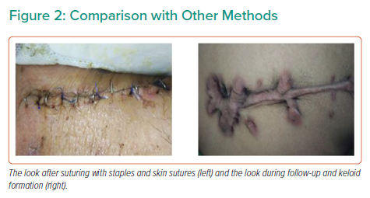
Monga IS
Comparison with Other Methods
Citation: Interventional Cardiology Review 2021;16:e18.
https://doi.org/10.15420/icr.2021.16.PO7

