Slide 1
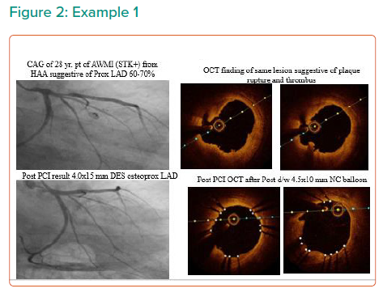
Monga IS, Kumar A, Girish R, Sood A
Example 1
Citation: Interventional Cardiology Review 2021;16:e19.
https://doi.org/10.15420/icr.2021.16.PO8

