Slide 1
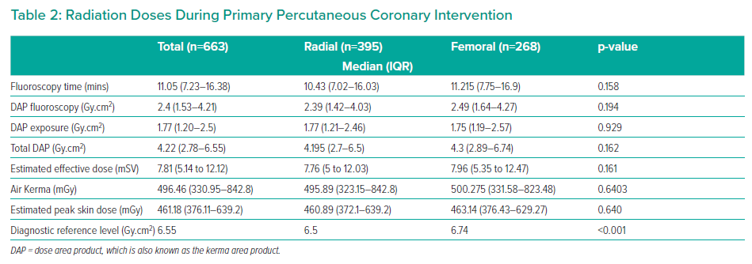
Yap EML, Macaraeg CA, Ayuson R, Tuazon AA, Estacio RH, Tria RB
Radiation Doses During Primary Percutaneous Coronary Intervention
Citation: Interventional Cardiology Review 2021;16:e21.
https://doi.org/10.15420/icr.2021.16.PO10

