Slide 1
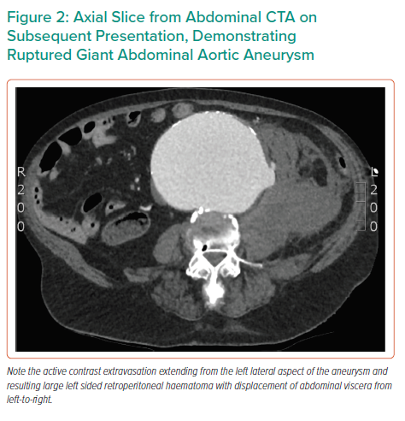
Williams AB, Lax LG
Axial Slice from Abdominal CTA on Subsequent Presentation, Demonstrating Ruptured Giant Abdominal Aortic Aneurysm
Citation: Interventional Cardiology Review 2021;16:e22.
https://doi.org/10.15420/icr.2021.16.PO11

