Slide 1
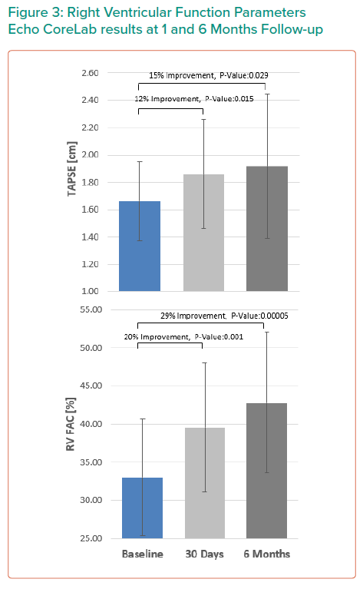
Topilsky Y, Yaron D, Bork M
Right Ventricular Function Parameters Echo CoreLab results at 1 and 6 Months Follow-up
Citation: Interventional Cardiology Review 2021;16:e23.
https://doi.org/10.15420/icr.2021.16.PO12

