Slide 1
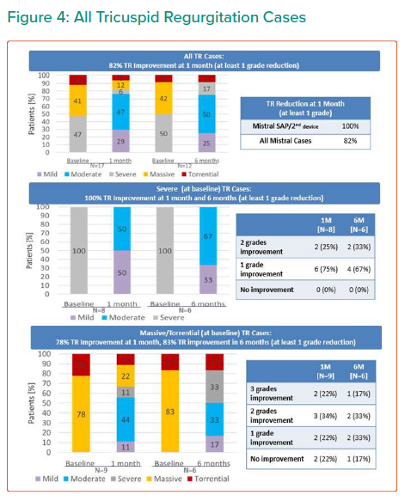
Topilsky Y, Yaron D, Bork M
All Tricuspid Regurgitation Cases
Citation: Interventional Cardiology Review 2021;16:e23.
https://doi.org/10.15420/icr.2021.16.PO12

