Slide 1
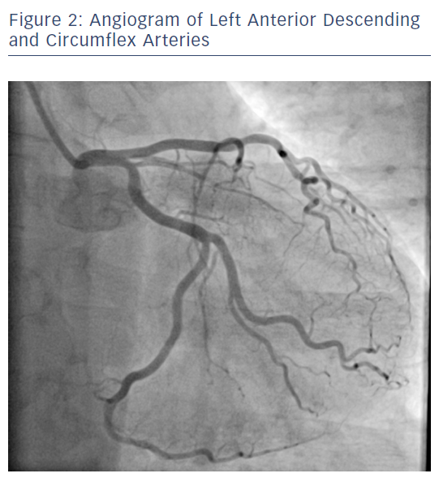
Ratib K, Nolan J
Angiogram of Left Anterior Descending and Circumflex Arteries
Citation: RadcliffeCardiology.com, June 2017.
https://doi.org/10.15420/rc.2017.m007

