Slide 1

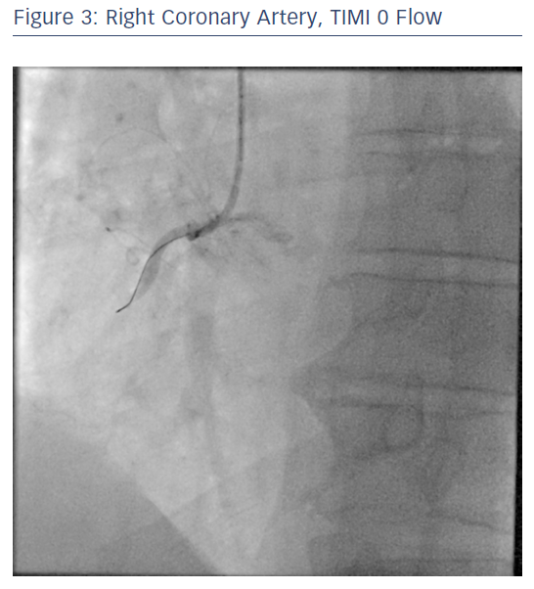
Ratib K, Nolan J
Right Coronary Artery, TIMI 0 Flow
Citation: RadcliffeCardiology.com, June 2017.
https://doi.org/10.15420/rc.2017.m007

