Slide 1
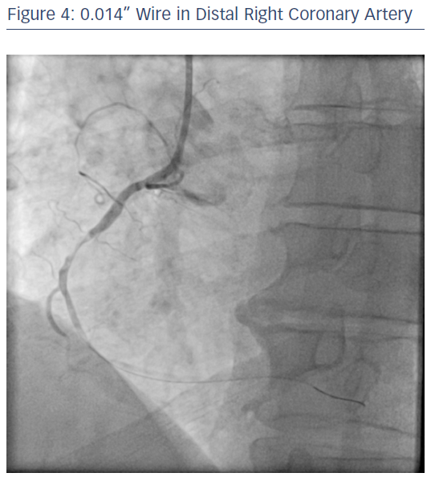
Ratib K, Nolan J
0.014” Wire in Distal Right Coronary Artery
Citation: RadcliffeCardiology.com, June 2017.
https://doi.org/10.15420/rc.2017.m007

