Slide 1
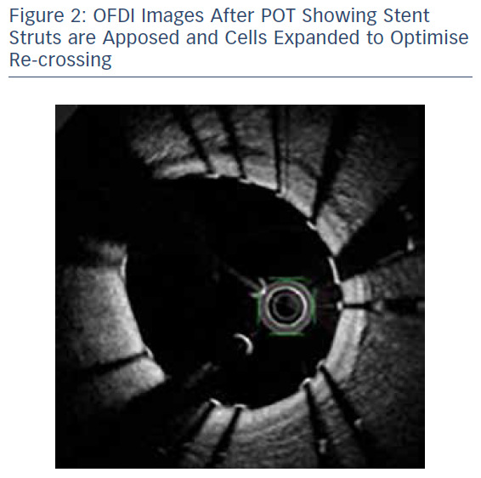
Khavandi A
OFDI Images After POT Showing Stent Struts are Apposed and Cells Expanded to Optimise Re-crossing
Citation: RadcliffeCardiology.com, November 2017.
https://doi.org/10.15420/rc.2017.m018

