Slide 1
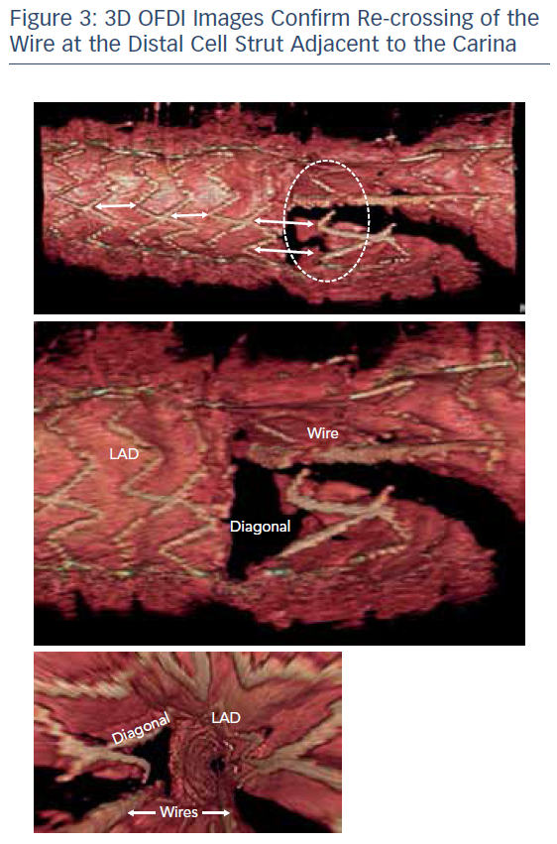
Khavandi A
3D OFDI Images Confirm Re-crossing of the Wire at the Distal Cell Strut Adjacent to the Carina
Citation: RadcliffeCardiology.com, November 2017.
https://doi.org/10.15420/rc.2017.m018

