Slide 1
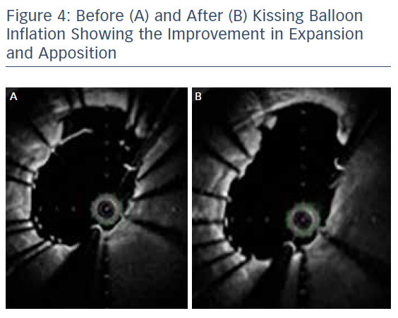
Khavandi A
Before (A) and After (B) Kissing Balloon Inflation Showing the Improvement in Expansion and Apposition
Citation: RadcliffeCardiology.com, November 2017.
https://doi.org/10.15420/rc.2017.m018

