Slide 1
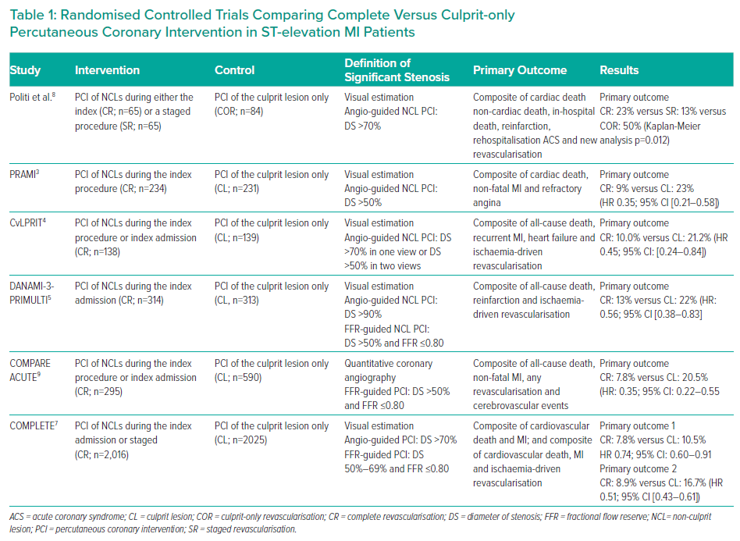
Serafino LD, Magliulo F, Esposito G
Randomised Controlled Trials Comparing Complete Versus Culprit-only Percutaneous Coronary Intervention in ST-elevation MI Patients
Citation: Interventional Cardiology Review 2021;16:e24.
https://doi.org/10.15420/icr.2020.28

