Slide 1
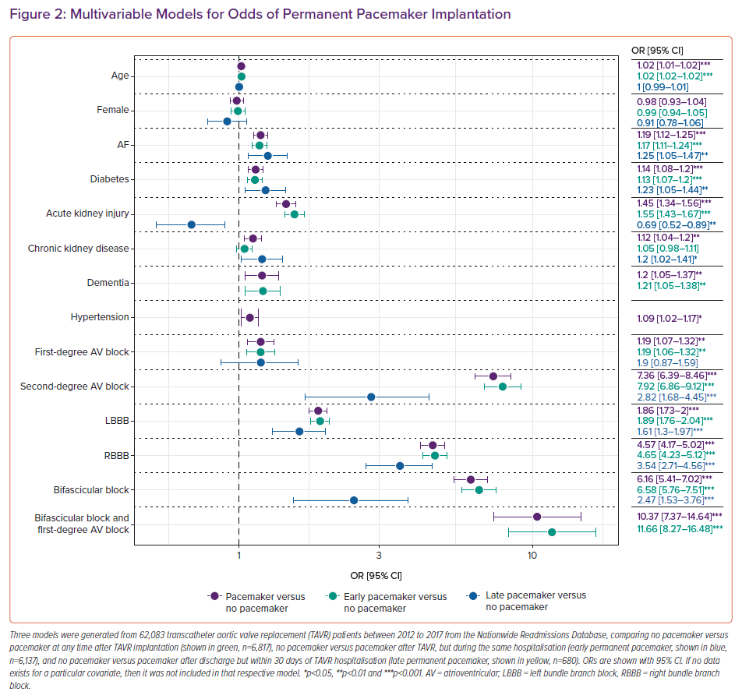
Mazzella AJ, Arora S, Hendrickson MJ, Sanders M, Vavalle JP, Gehi AK
Multivariable Models for Odds of Permanent Pacemaker Implantation
Citation: Cardiac Failure Review 2021;7:e12.
https://doi.org/10.15420/cfr.2021.05

