Slide 1
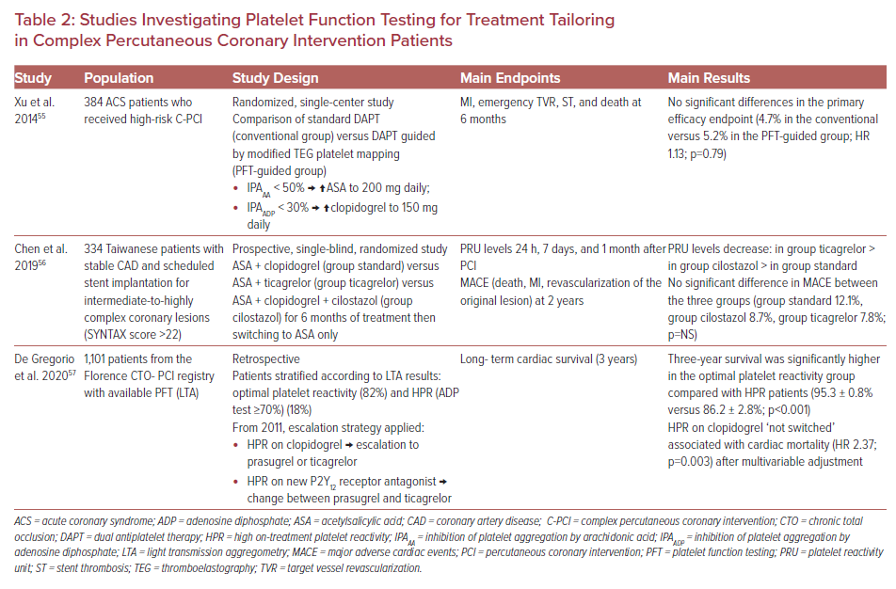
Moulias A, Papageorgiou A, Alexopoulos D
Studies Investigating Platelet Function Testing for Treatment Tailoring in Complex Percutaneous Coronary Intervention Patients
Citation: US Cardiology Review 2021;15:e14.
https://doi.org/10.15420/usc.2020.33

